Slide 1
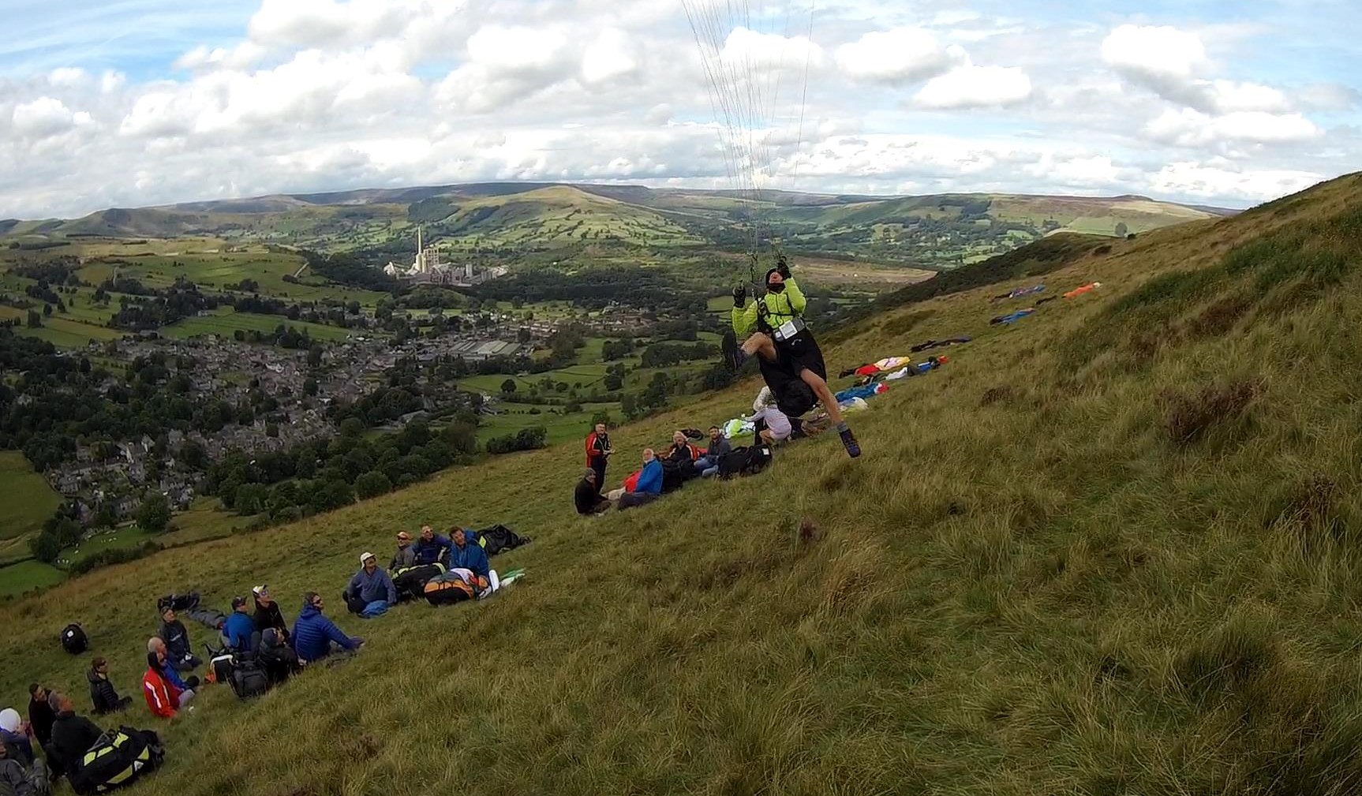
The Perils of Strong Wind
Paragliding
…. and how to recognise and mitigate the risks
Section 1/4 - Background Notes

Slide 2
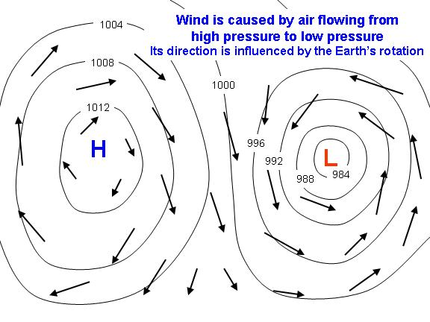
Background (wind – causes)
WIND is simply the movement of air (a gas) from
HIGH pressure to LOW pressure.
This occurs on:
i) a GLOBAL scale ii) LOCALLY
On a global scale it’s The Earth’s way of regulating pressure as different parts warm and cool at different rates and times.
At a local level it can be experienced/caused by any or a combination of
Sea Breezes
Solar Convection (thermals)
Inversions and any associated wave
The local topography
Combining with any prevailing meteo wind.
ALL the above influence the STRENGTH and DIRECTION
……. which can change VERY markedly and quickly.
Northern hemisphere
Any pilot, but especially those flying paragliders, need to also be students of meteorology.

Slide 3
Background (wind strength)
100 mph
80
60
40
20
0
TURBULENCE INTENSITY: Max speed range across 10 mins (gusts!)
PARAGLIDER: Trim speed approx 38kph (20mph)
WIND COMPONENT: Depending on the site
TEMPERATURE & AIR DENSITY.
ACCIDENTS: Many reports have fresh winds and turbulence as a factor
MJ
CA
Heli
SA
GD
RK
ML/HG
PG
BLN
More experienced
Less experienced
BLOWN OUT!
TOP END
PEACHY
SCRATCHY
0 10 - 14 mph 20

Slide 4
Turbulence!
An increase in wind = an increase in turbulence
Paragliders do not handle turbulence well; at best uncomfortable …at worst dangerous!
Essentially, two MAIN types
* Ground based – from any obstacle (trees, walls, buildings ) to
topographical features of the hill ( spines, outcrops, gullies etc)
Air based – thermal, convergence, wave, inversions, shear layers, fronts
Most turbulence is short lived – unless you’re in a bad place. Predict, move or use.
Lessons.
Know your limits and your skill / experience level
Understand how your glider behaves and your level of active piloting
From the take off to the landing it’s 100% in your hands to deal with whatever
is thrown at you.
Knowing your groundspeed is essential.
Ground turbulence is the most dangerous. Avoid going in close when it’s windy.
Build up your skills, exposure and confidence gradually. Confidence recovery
can be slow.

Slide 5
On the day
Roughly speaking – the forecast and site choice is fairly easy 20% of the time;
for the other 80% it can be anywhere from a well informed stab to a black art.
LOOKED AT PURELY THROUGH THE PRISM OF ---- WIND.
Decide if it’s a ‘flying day’ … or ‘blown out’.
You need to know wind direction and strength across your flying time period
Get a range of forecasts. See if they are in general agreement. They should
be fairly accurate from three days out … but still only an indicator.
National and regional wind speeds could easily double for flying sites.
Consider things that could change wind speeds across the flying day. These
could be – approaching front, sea breeze encroachment, wave, thermal strength.
Factor in local and site specific conditions.
Discuss with others, use groups, forums etc …any other opinions help a lot.
At this point you need to make a decision … but initially only to drive to a site.
The alternative is shopping, DIY, gardening, work …. Yes, tough choice.

Slide 6
The Perils of Strong Wind
Paragliding
Preparation, preparation, preparation and …. take off
Section 2/4 - On Site / launching

Slide 7
From arriving on site to in the air
Assessing conditions - What to look for? Using time. Observing. Taking advice
Options: Decide to fly. Wait a while. Decide not to fly
Beware of i) Peer pressure
ii) More experienced pilots making it look OK
iii) Changing conditions
iv) Your own desire to fly
There can be an inner battle between being over cautious and over confident
Preparation (Practical things –SITE)
Walk the site and decide best place to take off*, layout, do checks, stay warm,
clip in. They are not always the same for crosswinds, strong winds, crowds,
compression areas, rotor/roll etc. Observe any take off’s and take any lessons
from them. Good idea to check the top landing area too – you may need it.
* Take off area … should be as clean as possible with no obstacles/hazards
downwind … for some distance.

Slide 8
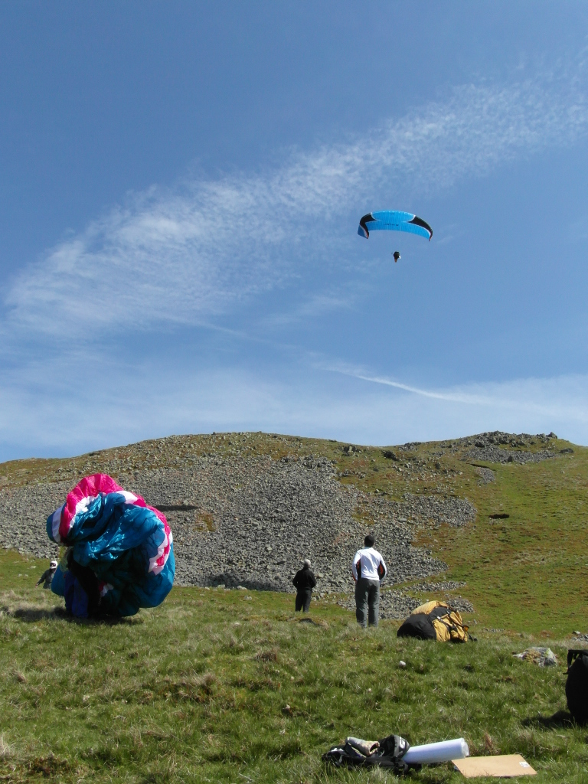
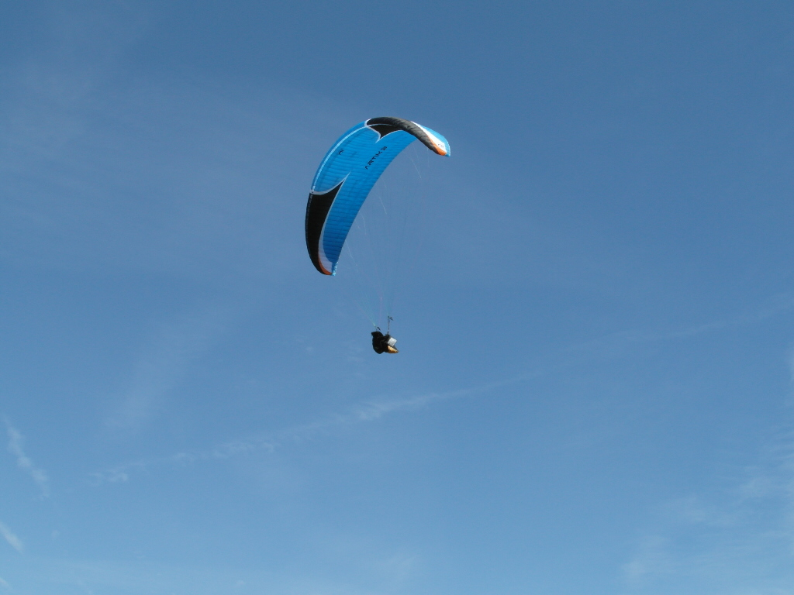
3. Preparation (Practical things –EQUIPMENT)
Find the most sheltered area and layout wing, check lines, harness, reserve
to the point where you are prepared to clip in. DON’T! Posie wing and weight
with harness with leading edge cells not collecting wind (laid back).
Set up instruments and attach.
Perfect take off, flight and top landing …. pilotless.

Slide 9
Preparation (Mental - get your mind focused)
Taking off in wind near the limits of your experience and skills needs a
focused mind with a clear idea of the all process. Think through what you are
doing, the order of actions and have a plan if it goes wrong – know how to
de-power the wing … fast!
Preparation (Practical – clipping in)
Helmet on! Clip into your harness in your layout/checks area. Do any last
minute line checks, especially brakes. Switch on instruments (radio when in the
air unless under coaching guidance). Gloves. Take the balled glider to the
take off area you selected earlier. (A good idea to ask someone to be a ‘watcher’
in case it goes wrong, and can quickly grab kill line before things get serious!)
FROM THIS POINT YOU MOVE INTO A TRIED and TESTED TAKE OFF PROCEDURE
Now it can get quite specific to you. There
are however a range of tried and tested techniques:
- Some easier than others,
- Some safer
- Some best suited to your wing
- Some you are most familiar with
- Some that de power the wing quickest.
Everyone, including very experienced pilots, get more stressed during a strong launch.

Slide 10
Some personal observation (and tips).
The wing - feed out the lines leaving the wing balled up, maybe tease a few centre
cells open and laid back.
Brakes in correct hands – on wrists.
Above 10mph the C riser is the key to getting the wing up in a controlled manner.
It will also stop you being yanked off the ground. Above 12 mph it’s essential.
You may get away with A’s and brakes, but only if you are adept enough to
catch the wing, don’t mind being lifted off, don’t avoid a frontal when you do
and can run fast when it goes wrong. Basically, in a strong wind it’s perilous!
I’ve never actually seen a full Cobra launch done in anger in a strong wind. I have
seen half Cobra’s in moderate smooth air.
The key (personally) is a combination of the right place, the right time followed by a
practiced technique. For me that’s A/C with a few subtle tweaks.
De-powering the wing is best done on the C’s … it’s far quicker than brakes, and no messing with wraps.
In (my view) all gliders should have C handles simply for launch safety (and high wind landings)
and ease. I have retro-fitted to some wings that didn’t have.
Many EN D and EN C three liners are easier to launch than EN A wings in strong winds. Faster through
the power window.

Slide 11
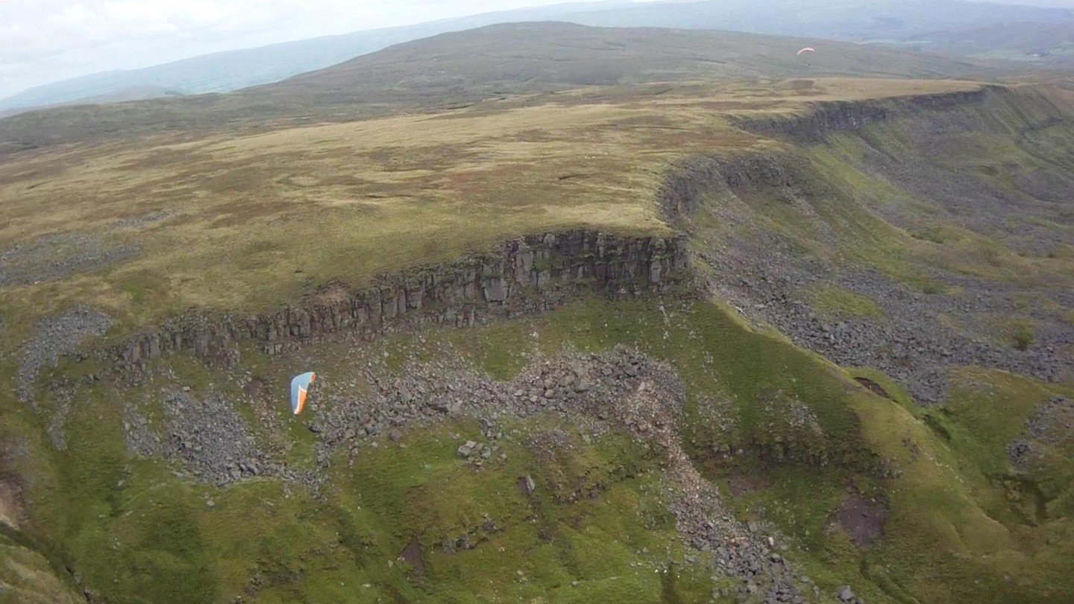
The Perils of Strong Wind
Paragliding
exploring the ridge
Section 3/4 - On the ridge

Slide 12
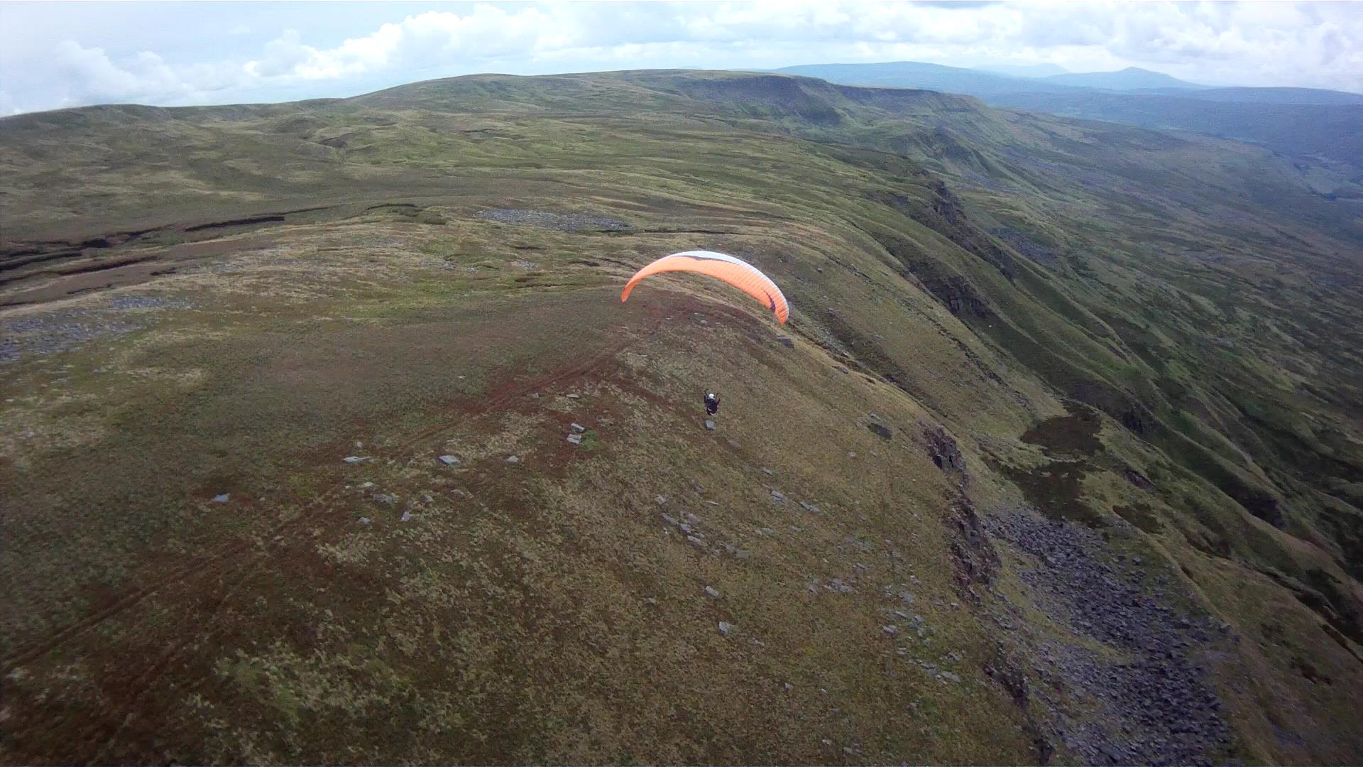
Checking out the ridge
Some ridges are more complex and featured than others.
Some ridges are less tolerant of wind shifts – increase in turbulence
Some ridges are less tolerant of wind increases - eg shallow slopes
It’s simply a case of monitoring wind speed and direction and applying some
imagination . HIGH – OK …. but close in care required.

Slide 13
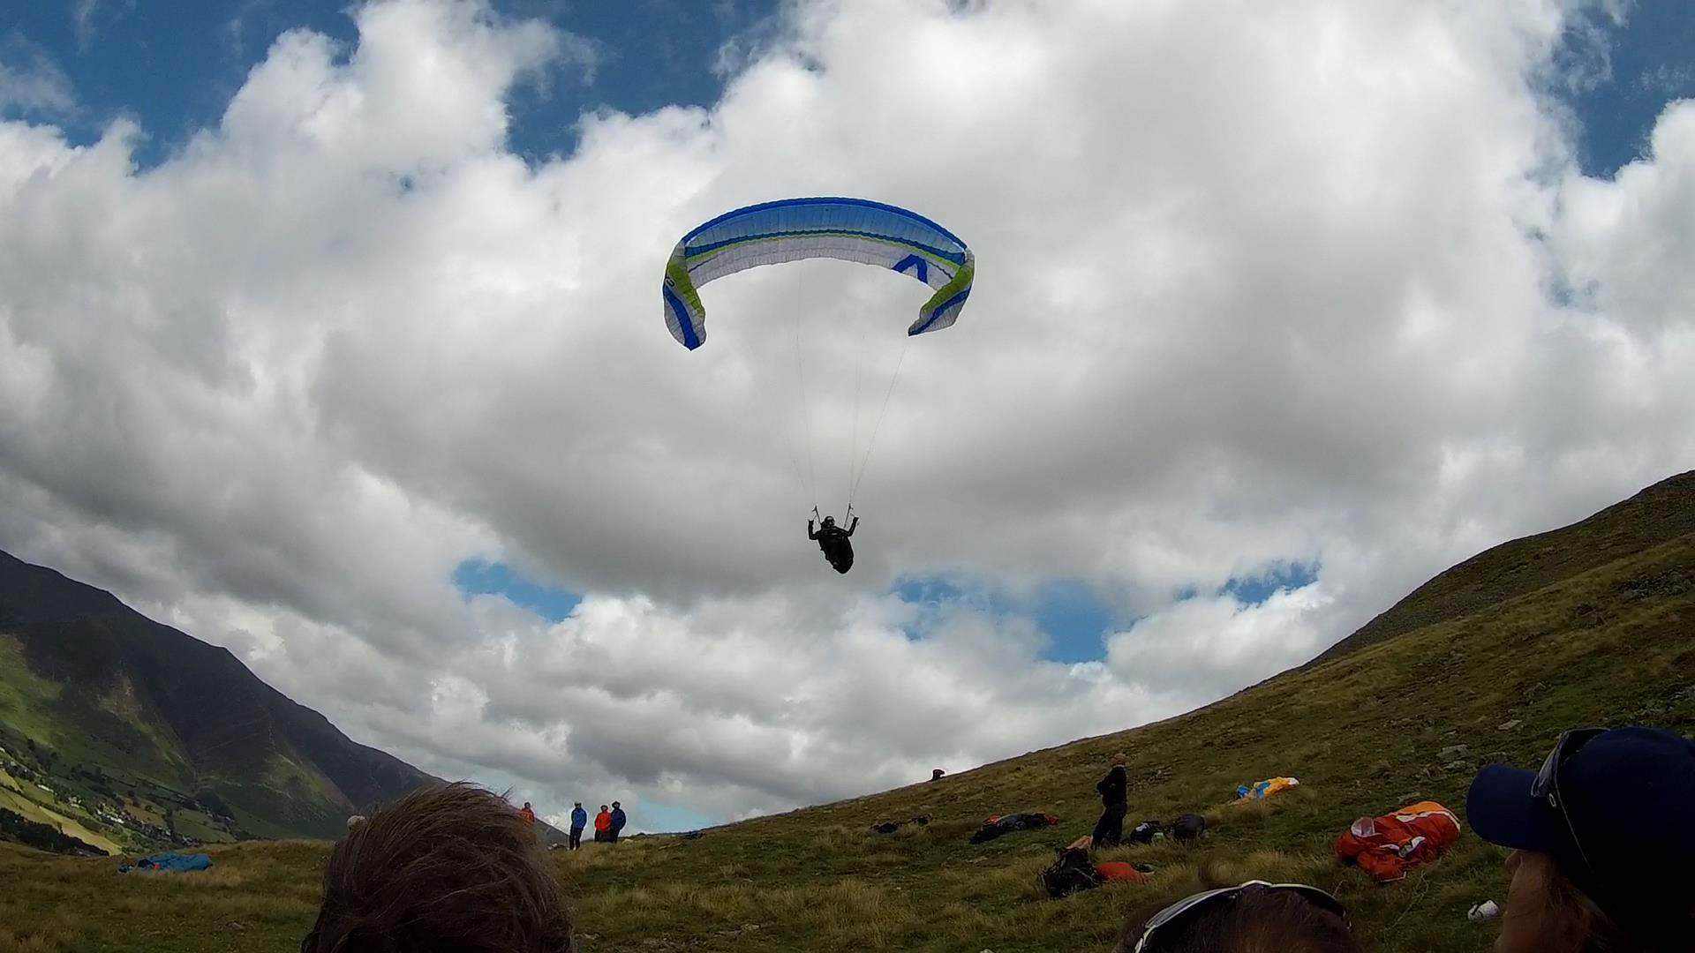
The Perils of Strong Wind
Paragliding
top landings, bottom landings and out-landings
Section 4/4- Landing

Slide 14
High wind landings can be split essentially into three:
Top landings
Bottom landings
Outlandings
Top landings – BEFORE you took off you should have checked out the top landing
checking slope, surface, size and downwind hazards.
- ASKED for any advice, especially if it’s still fairly new to you.
- Considered the best APPROACH from ridge to touchdown
- BEWARE going too far back … stay well forward
- Have a glider DE-POWER technique in mind.
- If you get the opportunity to observe a landing … do so. If no one is landing
question why.
- Know your plan B …. probably the bottom landing.

Slide 15
Bottom landings – BEFORE you took off you should have checked out the bottom
landing location checking slope, surface, size and downwind hazards.
- ASKED for any advice, especially if it’s still fairly new to you.
- Considered the best APPROACH from ridge to touchdown
- Be AWARE of the wind gradient. In fresh wind they can be quite marked.
- Have a glider DE-POWER technique in mind.
Out- landings – ANY landing away from the usual site options is an out landing – be that a few
kilometre to hundreds of kilometres. Therefore it’s not just the preserve of the xc pilot.
- There are a range of skills that every pilot needs to develop in assessing an unknown
landing . Under some circumstances one of your options may be the biggest, most open
and safe option.
- ASSESS (from the air) possible landing options, (have several in mind). Consider all the
following factors: size, slope, hazards (especially powerlines), any turbulence generators,
trees, field boundaries, buildings, crops, livestock (avoid horses at all costs!) If you have
any bandwith left … look for the exit gate, followed by the pub and the bus stop.
- If you have zero forward speed at 400’ the chances are you’ll land with reasonable
forward speed due to the wind gradient. Keep speed on during the final 100’ …. a severe
wind gradient can lead you near the stall.
- Out landings, once you develop the assessment skills, are generally some of the easiest.

Slide 16
Zzzzzzzz

